Slide 1

Ohio: The State of Gaming
Senator William P. Coley II

Slide 2
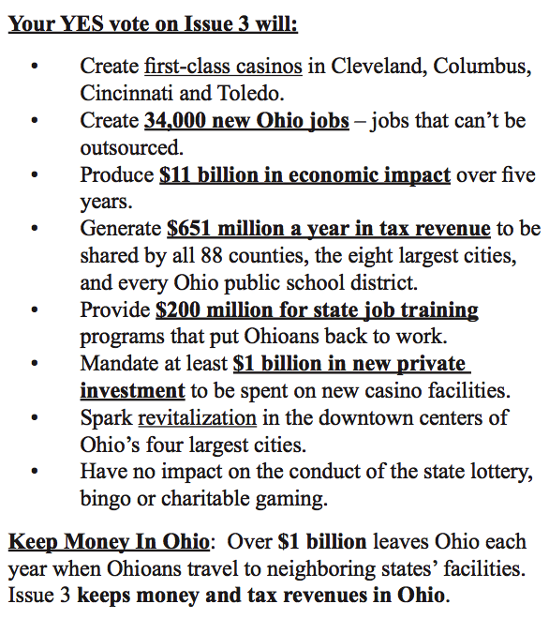


To date:
15,444 jobs
Through June 2016
$1,058,538,617.43
Notes:
http://www.sos.state.oh.us/sos/upload/publications/election/Issues_09.pdf
$ 179,870,019.25
833625888.25

Slide 3

Inflated Promises of Job Creation
According to the Ohio Casino Control Commission’s Annual Report, as well as a Columbus Dispatch review of the claims
“There are 4,844 employees at the four casinos.
Add 10,600 temporary jobs created during construction and the total is
15,444 jobs, less than half the 34,000 promised.”
Notes:
http://www.dispatch.com/content/stories/local/2014/09/01/promises-dont-pan-out.html
2014 Ohio Casino Control Commission Report

Slide 4
Revenue Estimates
During the lead up to Issue 3, several reports were conducted to estimate casino revenue for the State of Ohio, and a derivative of Newton’s Law of Universal Gravitation was used to produce an estimate of $470 Million-
P_{i} x P_{j}
K
x
d_{ij}2
The Issue- P_{i} in the formula assumed nearly 19,000 gaming positions, but the reality has fallen far short (11,243)
Notes:
Newton's Law of Universal Gravitation: two bodies in the universe attract each other in
proportion to the product of their masses and inversely as the square distance between them.
Thus, expected interaction between gaming venue i and market area j is shown as:
where Pi = the gaming positions in gaming venue i, Pj = the population in market area j, dij = the
distance between them, and k = an attraction factor relating to the quality and amenities to be
found at each gaming venue in comparison to the competing set of venues. When this
formulation is applied to each gaming venue gaming trips generated from any given zip code are
then distributed among all the competing venues.

Slide 5
Why so off on Projections?
Several factors have had a serious impact:
Underbuilding
Promotional Spend

Slide 6
“500 Million in Taxes a Year”
Issue 3 advocates estimated $651 million/year in tax revenue (Revised estimate of $470 million/year with racinos open as well)
Only 11,243 of 19,000 gaming positions used in estimates were built (59.17% of projections)
Average tax revenue from Casino AGR has been $ $268,713,432.10 , 57.2% of the $470 million/year estimate.
Projections were spot on (and even understimated when the $26,346,624.40 of lost tax revenue to promotional play every year is considered)
Notes:
2012-http://casinocontrol.ohio.gov/Portals/0/2012%20Ohio%20Casino%20Revenue%20Report.pdf
2013-http://casinocontrol.ohio.gov/Portals/0/December%202013%20Casino%20Revenue%20Report.pdf
2014-http://casinocontrol.ohio.gov/Portals/0/Revenue%20Reports/2014/December%202014%20Casino%20Revenue%20Report.pdf
We have the OBM report on this
# Due to incomplete year, not included for yearly average
* Does not include Jan or Feb for Horseshoe in Cincinnati
6

Slide 7
Promotional Spend
Year | Promo Spend | Lost Potential Taxes
2012 | $ 9,948,275.00 | $ 3,282,930.75
2013 | $ 117,390,470.00 | $ 38,738,855.10
2014 | $ 102,928,980.41 | $ 33,966,563.54
2015 | $ 115,166,749.10 | $ 38,005,027.20
2016 | $ 53,756,807.19 | $ 17,739,746.37
Total | $ 399,191,281.70 | $ 131,733,122.96
Promotional spend as a percentage of Adjusted Gaming Revenue has been 12.4%
Notes:
These are the same figures from the large excel spreadsheet you sent me, just in a different format and condensed for presentation purposes.
put total below lost potential taxes
Through June
7

Slide 8
Average Annual Tax Revenue Projections
 | Projected | Revised Projection | Promotional Loss | Actual Revenue | % over/under
 | $ 470,000,000.00 | $ 278,099,000.00 | $ 26,346,624.40 | $ 268,713,432.10 | 6.10%
When formula accounts for fewer positions actually built
With inclusion of taxed promotional play

Slide 9
Bottom Line
Gaming positions used in revenue estimate models were underbuilt by 40.87%
Average annual tax receipts have been 42.80% lower than the projection of $470 Million per year
$400 Million in promotional gaming credits not taxed (and not included in the original Constitutional Amendment)
How long are we going to continue a constitutionally protected monopoly for individuals who have shorted Ohio tax payers hundreds of millions of tax dollars?

